Slide 1

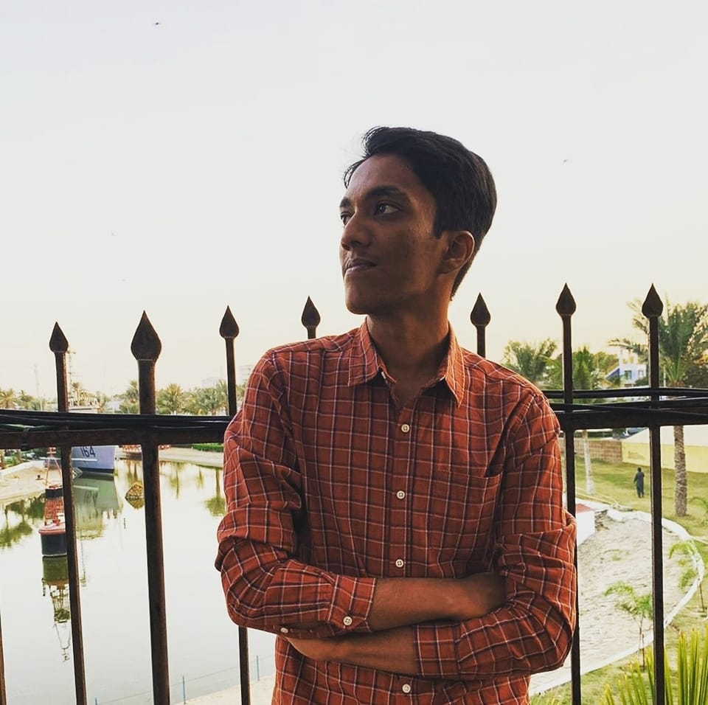

Ahmed Malik
We Hawt
A presentation about myself.

Slide 2

Things you need to know:
Hello!
My name is Ahmed Malik.
I am 18 years old.
I am currently a freshman at the Institute of Business Administration, Karachi.
I am enrolled in the BBA Program.
I have completed my O’ and A’ Levels from Beaconhouse School System.
I am a huge cricket and football fan.

Slide 3

Education
I completed my pre-school at The Civic School.
I got my primary education from Beaconhouse School System, Gulshan Primary IV.
The middle school I went to is BSS Gulshan Middle I.
I completed my secondary education (O’ Levels) from BSS Gulshan Cambridge with the grades; 4 A*s, 2 As and 3 Bs.
During my higher secondary education (A’ Levels), I was at Beaconhouse College Program, Gulshan Campus.
I passed A’ Levels as a valedictorian with the grades; 4 A*.

Slide 4
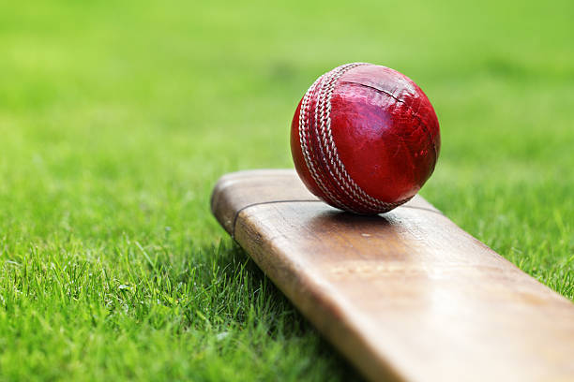

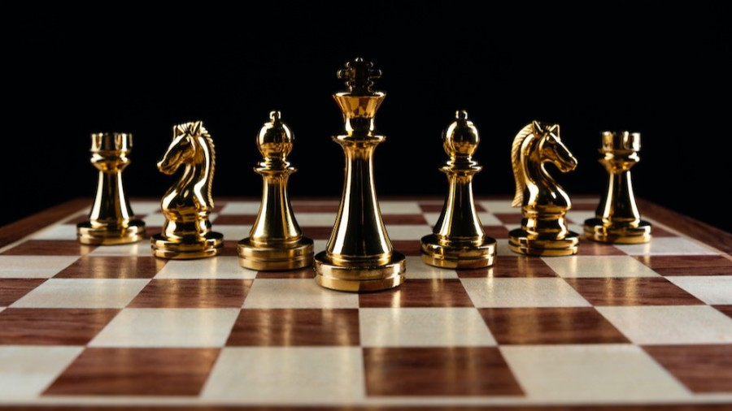
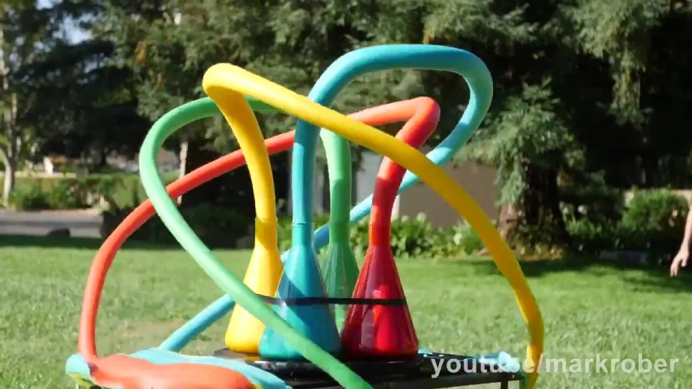
Hobbies
I love to play football.
I love playing chess
I love playing cricket
I love playing video games.
I love to watch science experiment videos on YouTube.
I try to learn some new skills through online courses.
I love watching movies & TV Shows.

Slide 5

Goals
My goals are to graduate from IBA with a respectable GPA.
I want to pursue an MBA degree in future
I want to become a prominent businessman in Pakistan.
I want to continue my Father’s Business and take it to an international level.
I want to start a community welfare organization to help the needy.

Slide 6
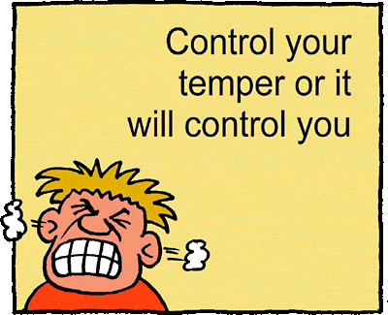

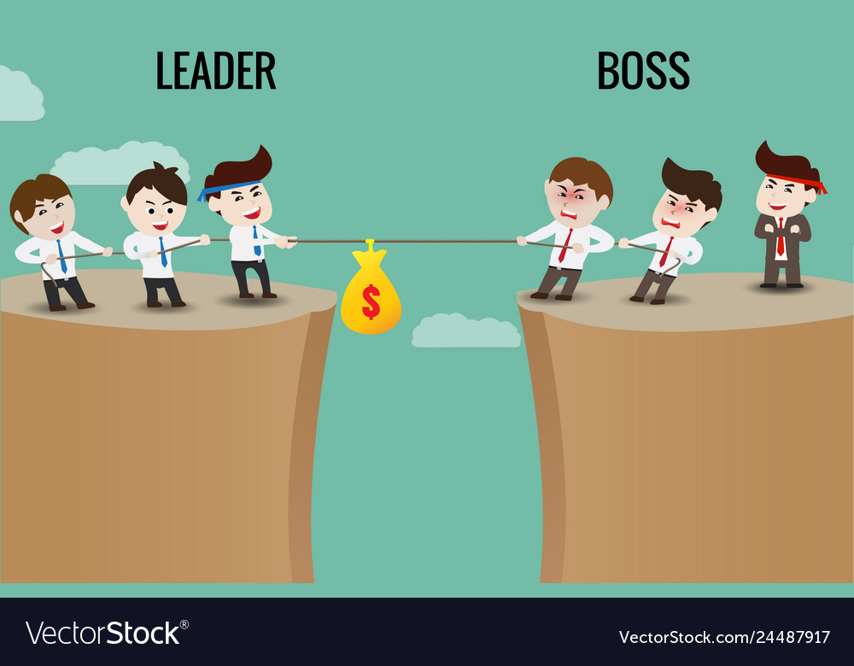
Strengths
I am punctual.
I have good control on temper.
I am a good team player.
I am honest and hardworking.
I can be a good leader.

Slide 7

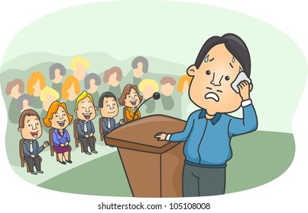
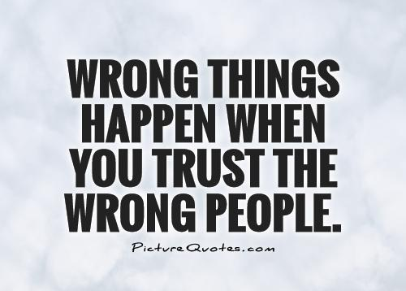
Weaknesses
Procrastination
Introversion
Stage Fright
Easily trust anyone
Getting hurt by same thing/ person twice.

Slide 8




Favorite Sports Teams

Slide 9


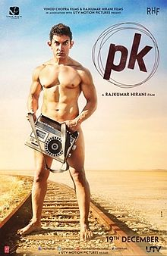

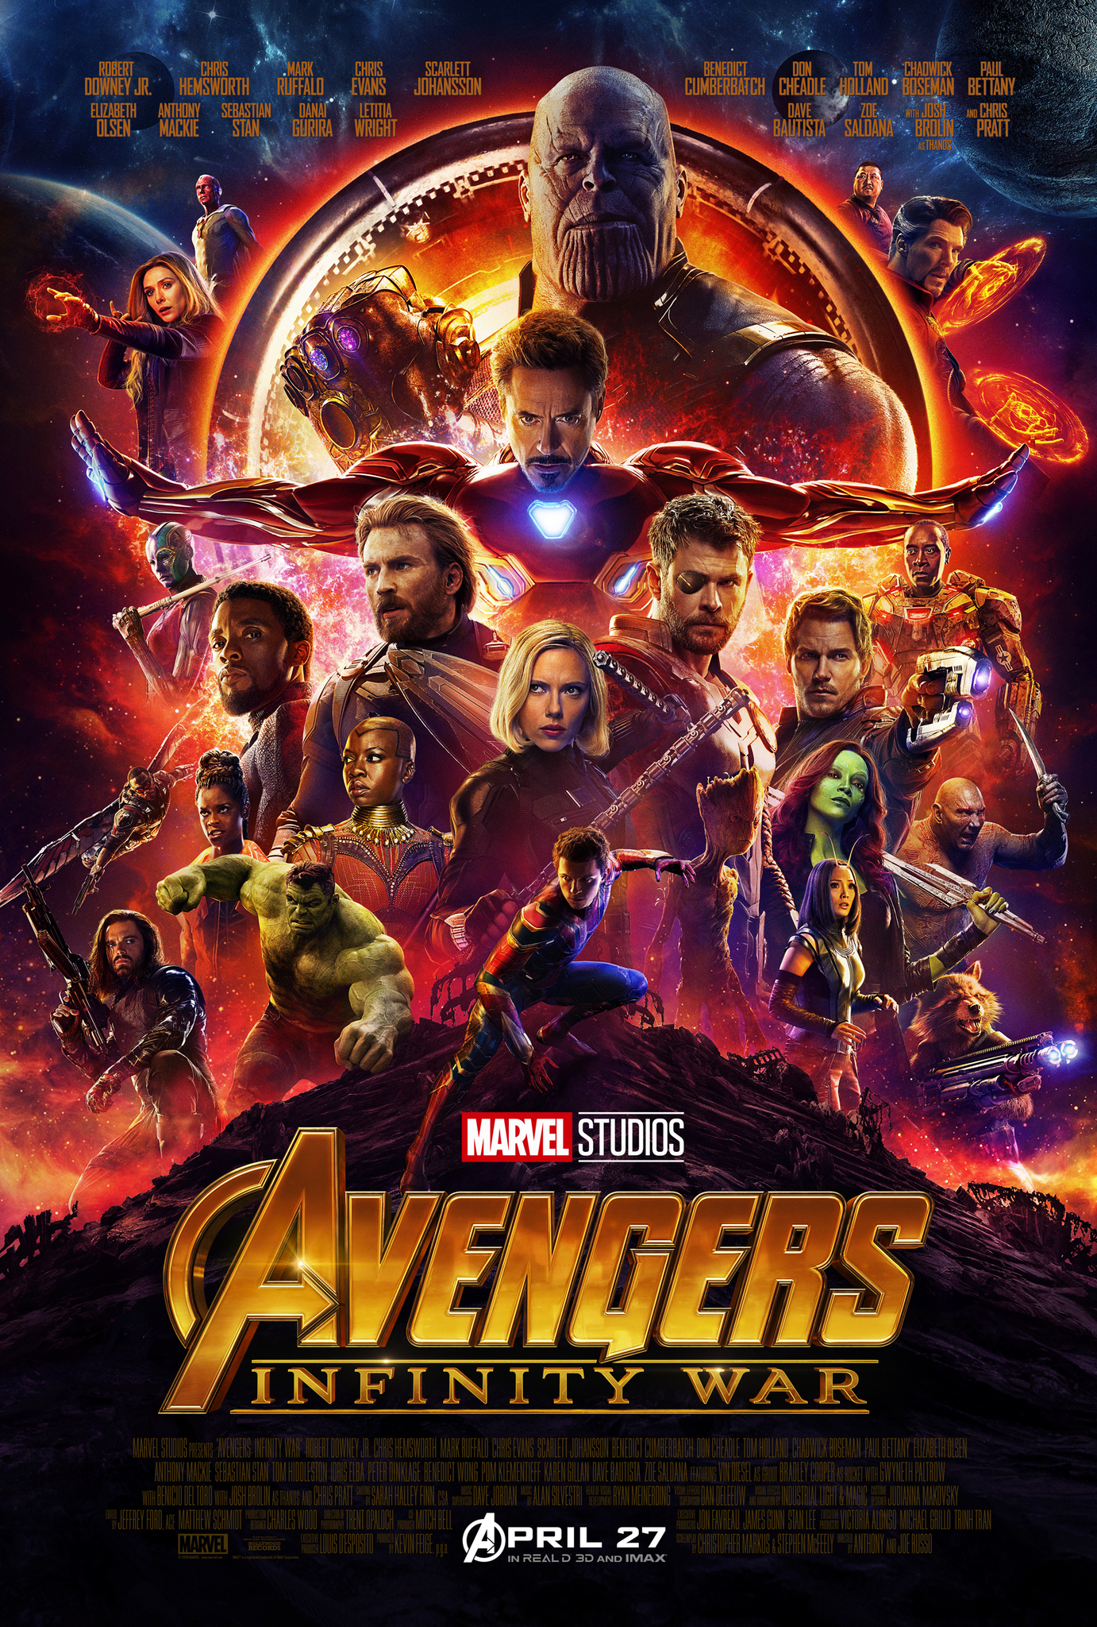

Favorite Movies

Slide 10

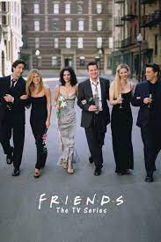



Favorite TV Shows

Slide 11
THANK YOU

